Slide 1


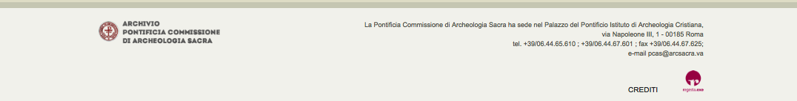
The PCAS
Photographic Digital Archive:
Fruition of Epigraphic Images
Agnese Pergola, Barbara Mazzei

Slide 2
The project of a Digital Photographic Archive of the Pontifical Commission for Sacred Archaeology (www.archeologiasacra.net) was initiated in order to facilitate access for scholars all over the world to the tens of thousands of negatives, films, and print images stored within the Photografic Archive, otherwise inacessible if not on site. Among the collected images are around 16.000 photographs representing Greek and Latin epigraphs of Christian catacombs in Italy, including not only Christian but also pagan inscriptions.
We show here some cases of fruition of epigraphic texts for which a better reading is made possible thanks to the digital images of the Photographic Archive of the PCAS.

Slide 3
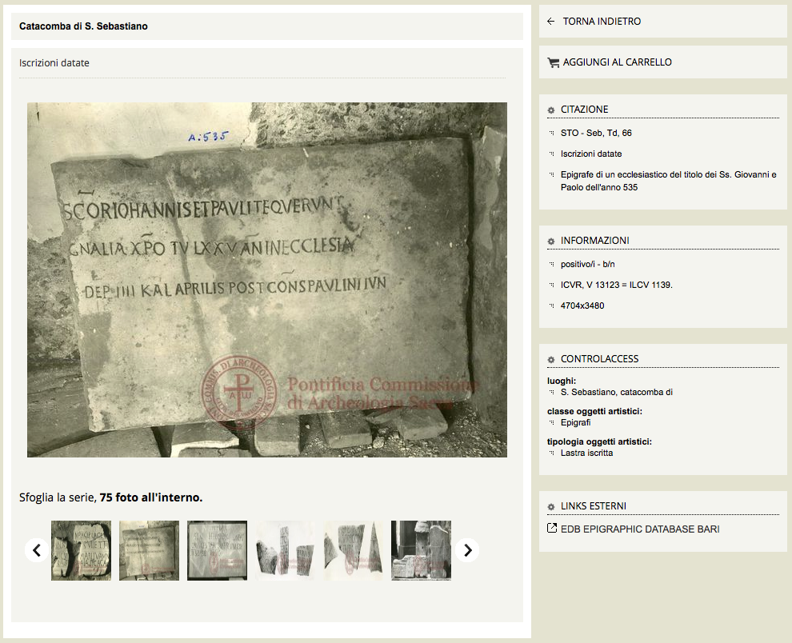
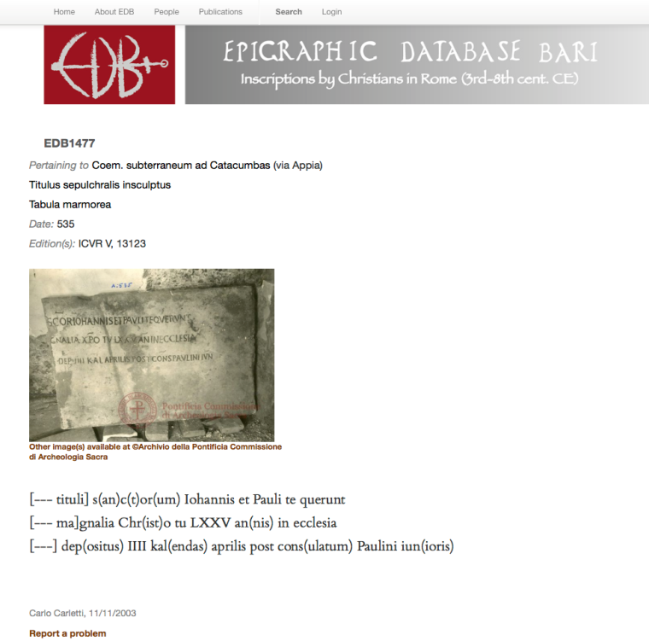
The project has acknowledged a constant increase in the collected items over the last years owing to the cooperation agreement with Epigraphic Batabase Bari (www. edb.uniba.it) and has provided a new approach to the study of early-christian epigraphy within the roman domain.

Slide 4
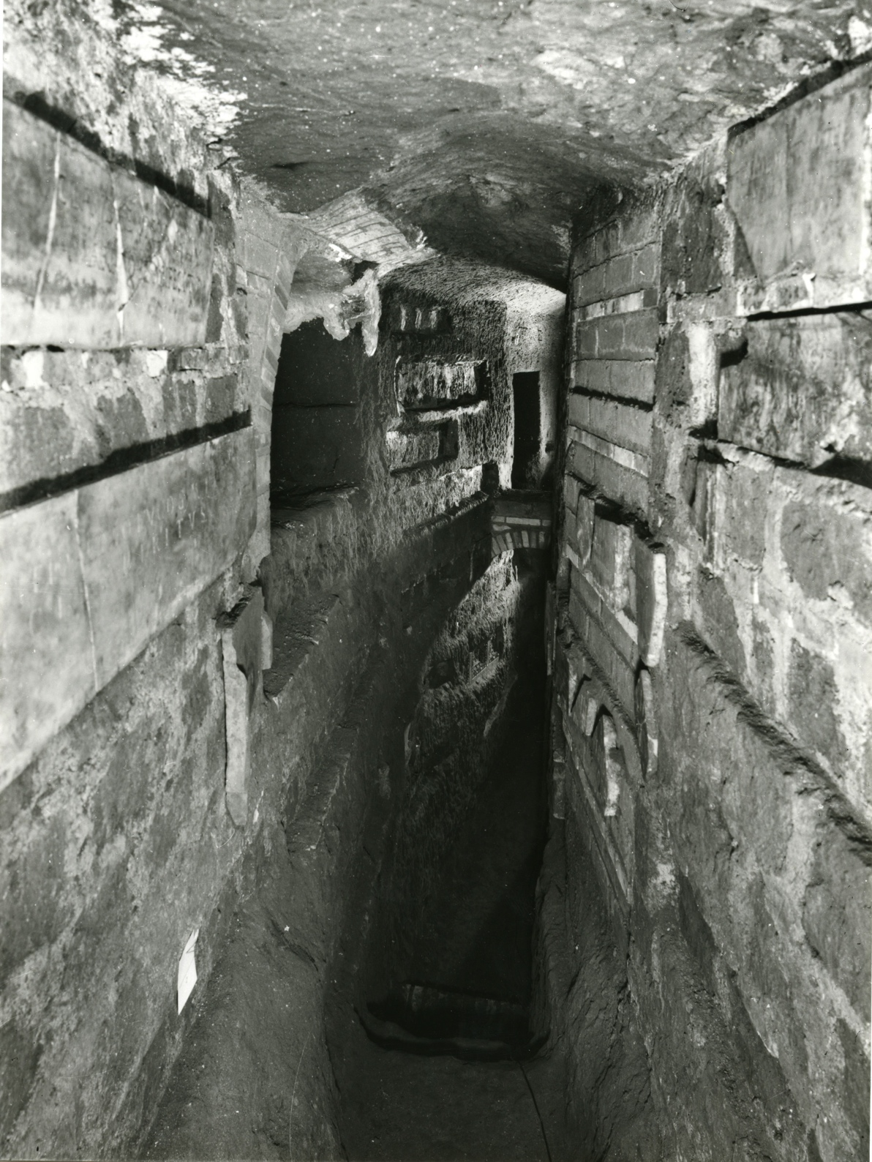
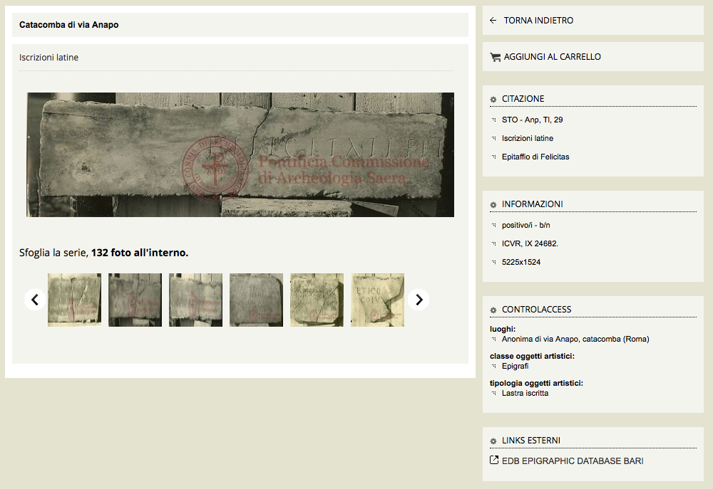
Users can wiew photographs in very high-resolution images displayed in a layout that presents facts about the photographic document, localization of the photographed item and the relevant technical and bibliographical information. In some cases the help of the photo is even better compared to a direct vision of the monument.

Slide 5
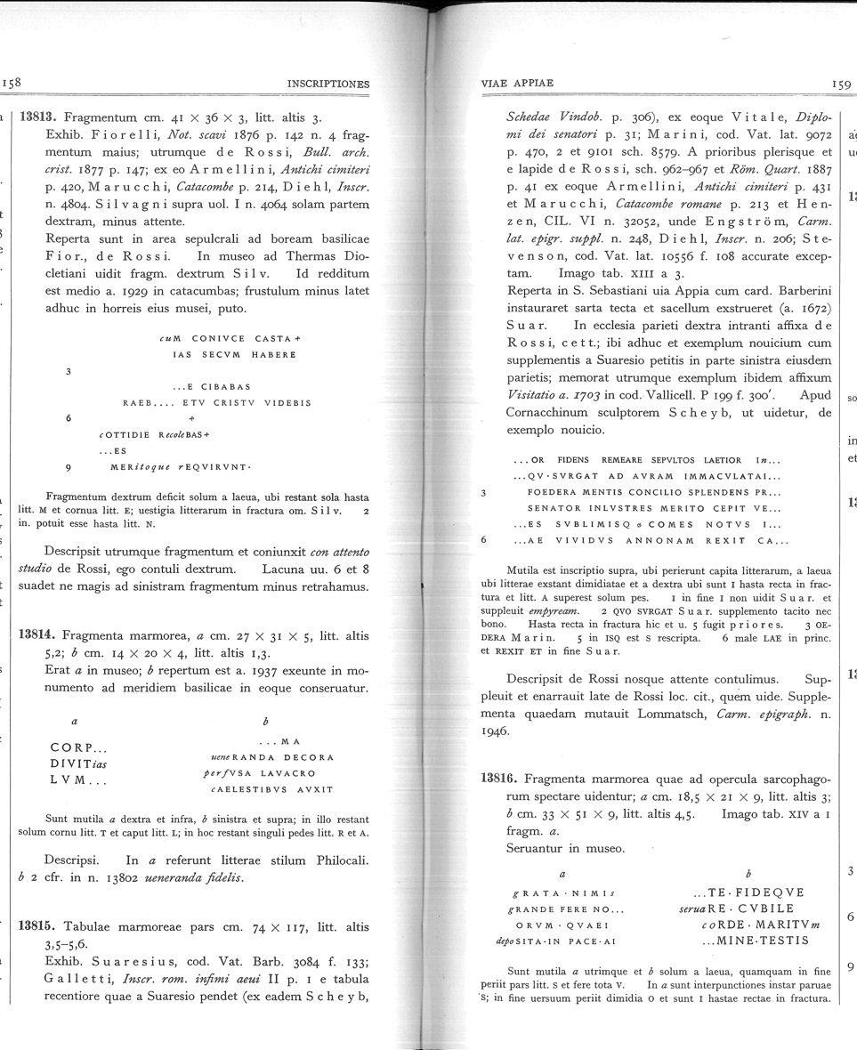
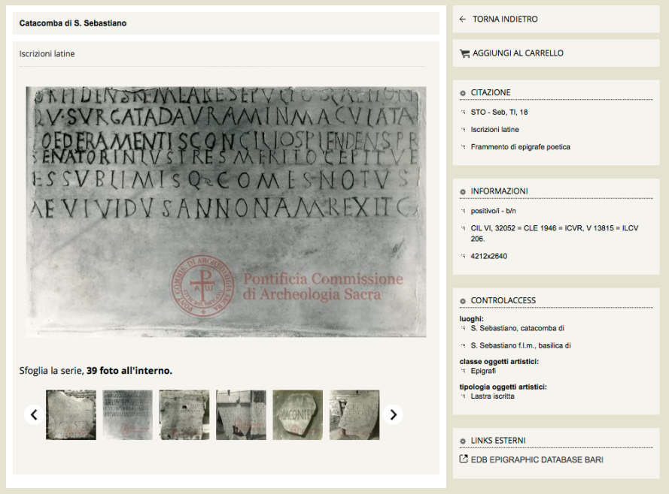
Viewing the image as well as the transcription gives the opportunity to compare text and artifact according to the criterion adopted by the modern paper publications, and have allowed a reconsideration of the transcriptions reported within the ICVR.

Slide 6
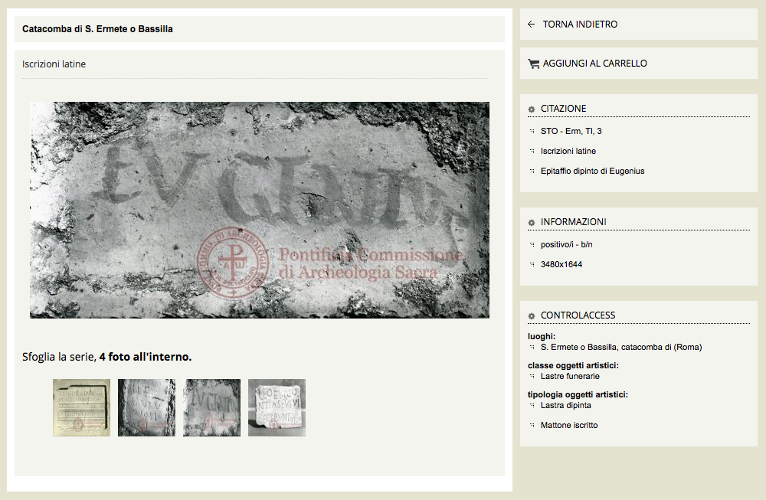
The Photographic Archive also contains unedited images of inscriptions fron the catacombs that are not listed in the larger epigraphic corpora. The chance to see these texts provides one more tool to the scholars.

Slide 7
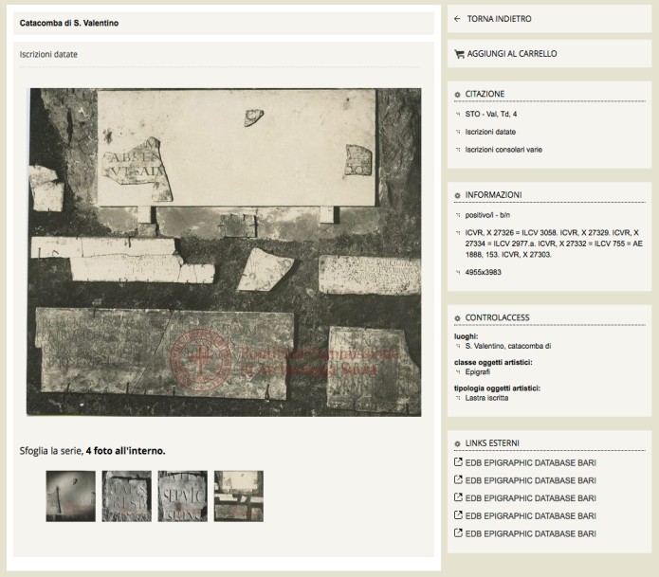
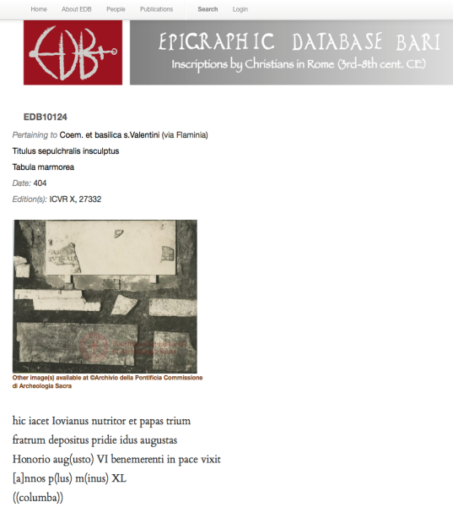
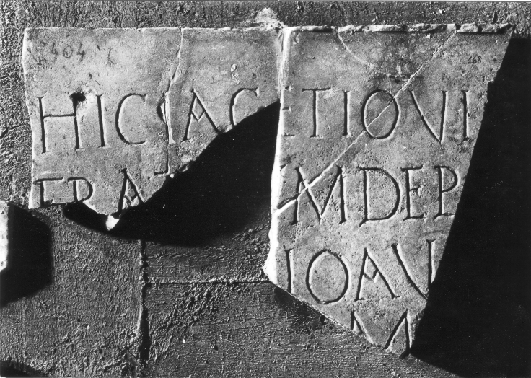
Present state after 1986
The images stored in the Historical Archive allowed, sometimes, to reconstruct the original condition of epigraphic materials that, in recent times, have been lost. This is the case of many fragments of inscriptions in the St. Valentine catacombs whose tunnels collapsed in 1986, causing the loss of a large number of inscriptions.

Slide 8
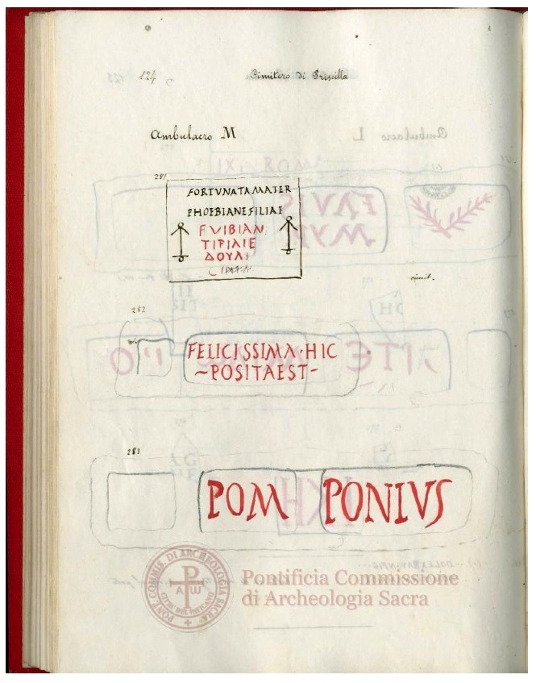
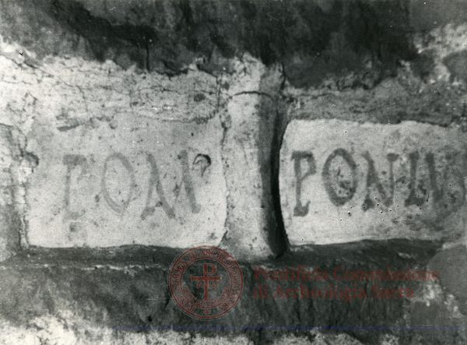
”C.D.A.S. Giornale degli scavi 1879-80"
From other documents stored in the Historical Documents Archive it is possible to retrieve some additional informations about inscriptions, like the time and the state of conservation at the moment of the discovery.

